Slide 1

Proverbs Brought to Life in an integrated classroom

Slide 2
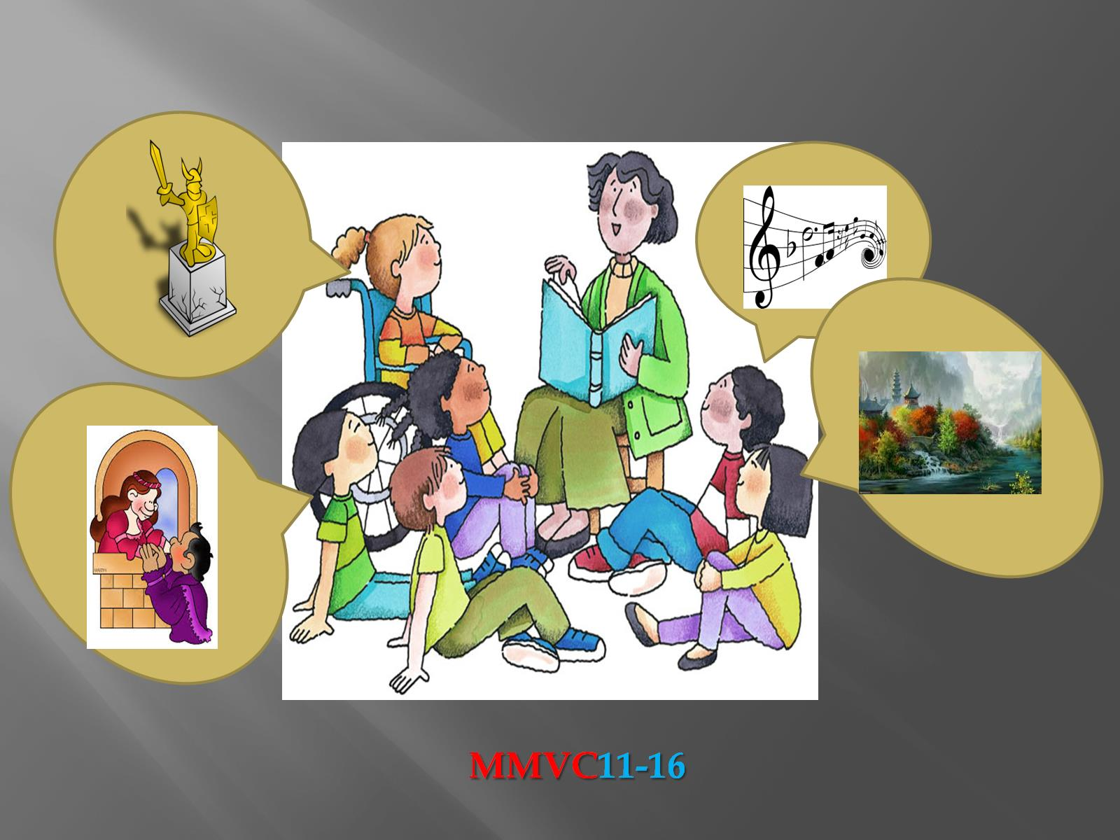

Slide 3


Slide 4

Proverbs

Slide 5
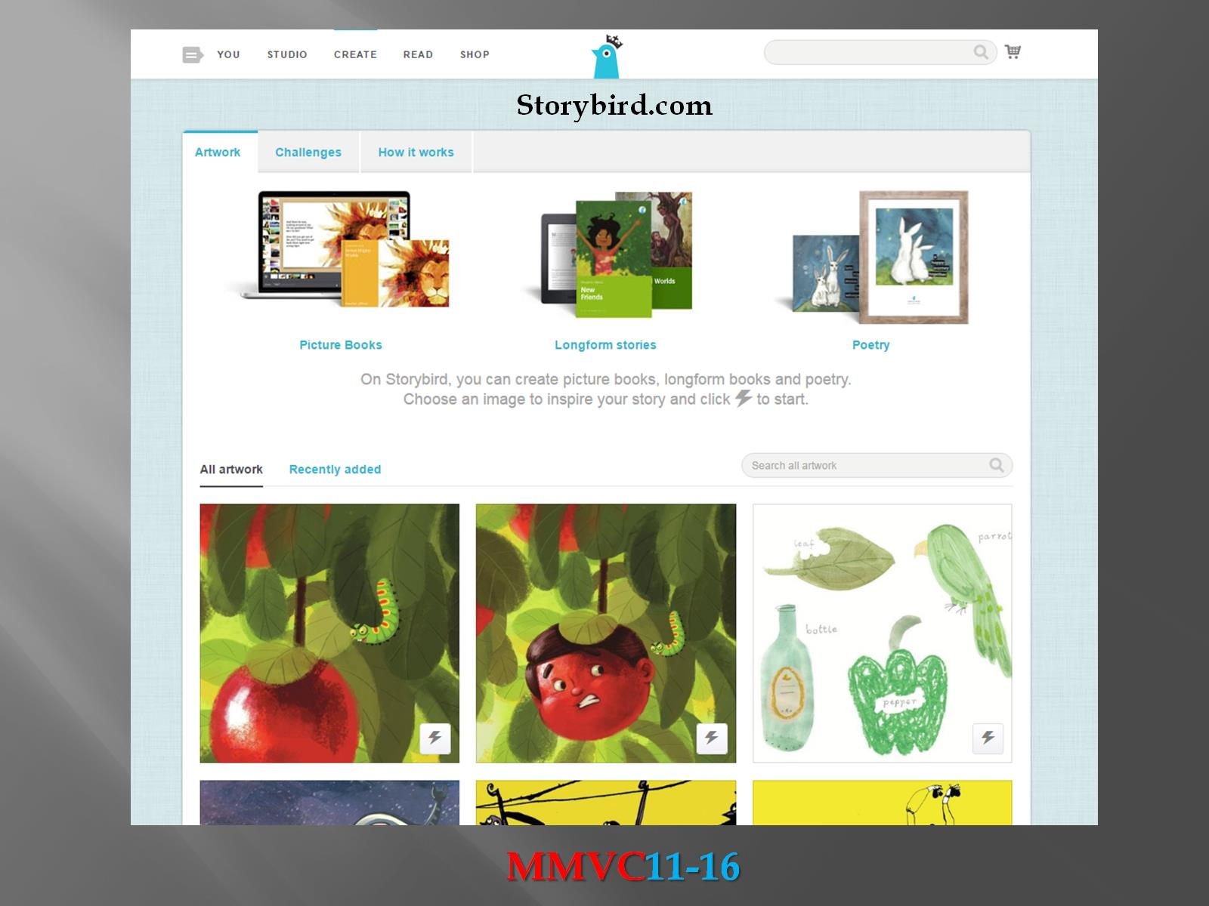

Slide 6


Slide 7


Slide 8
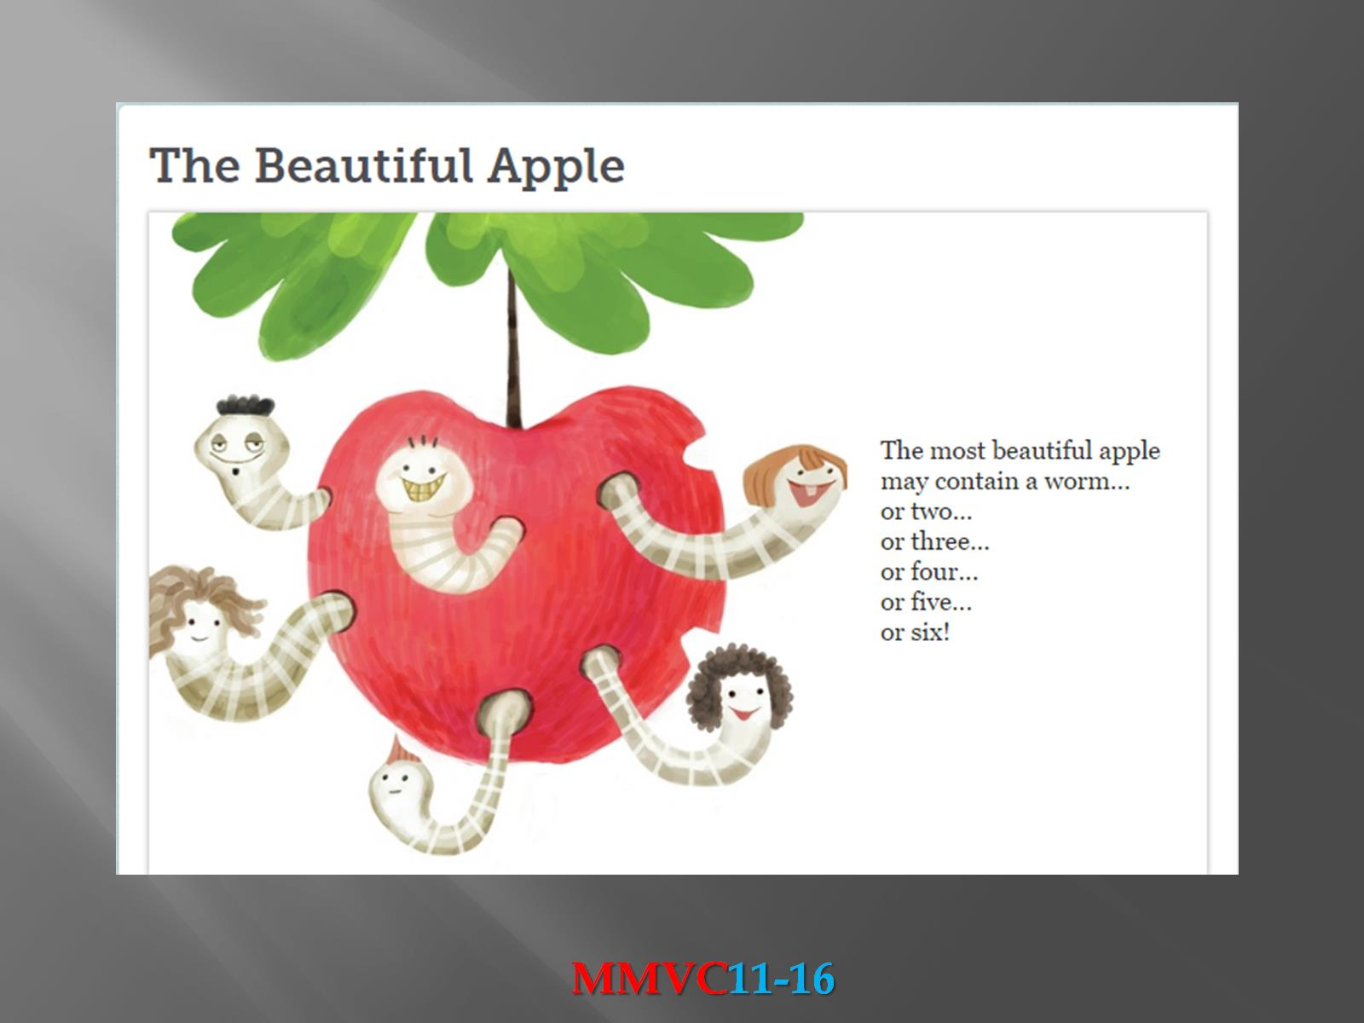

Slide 9
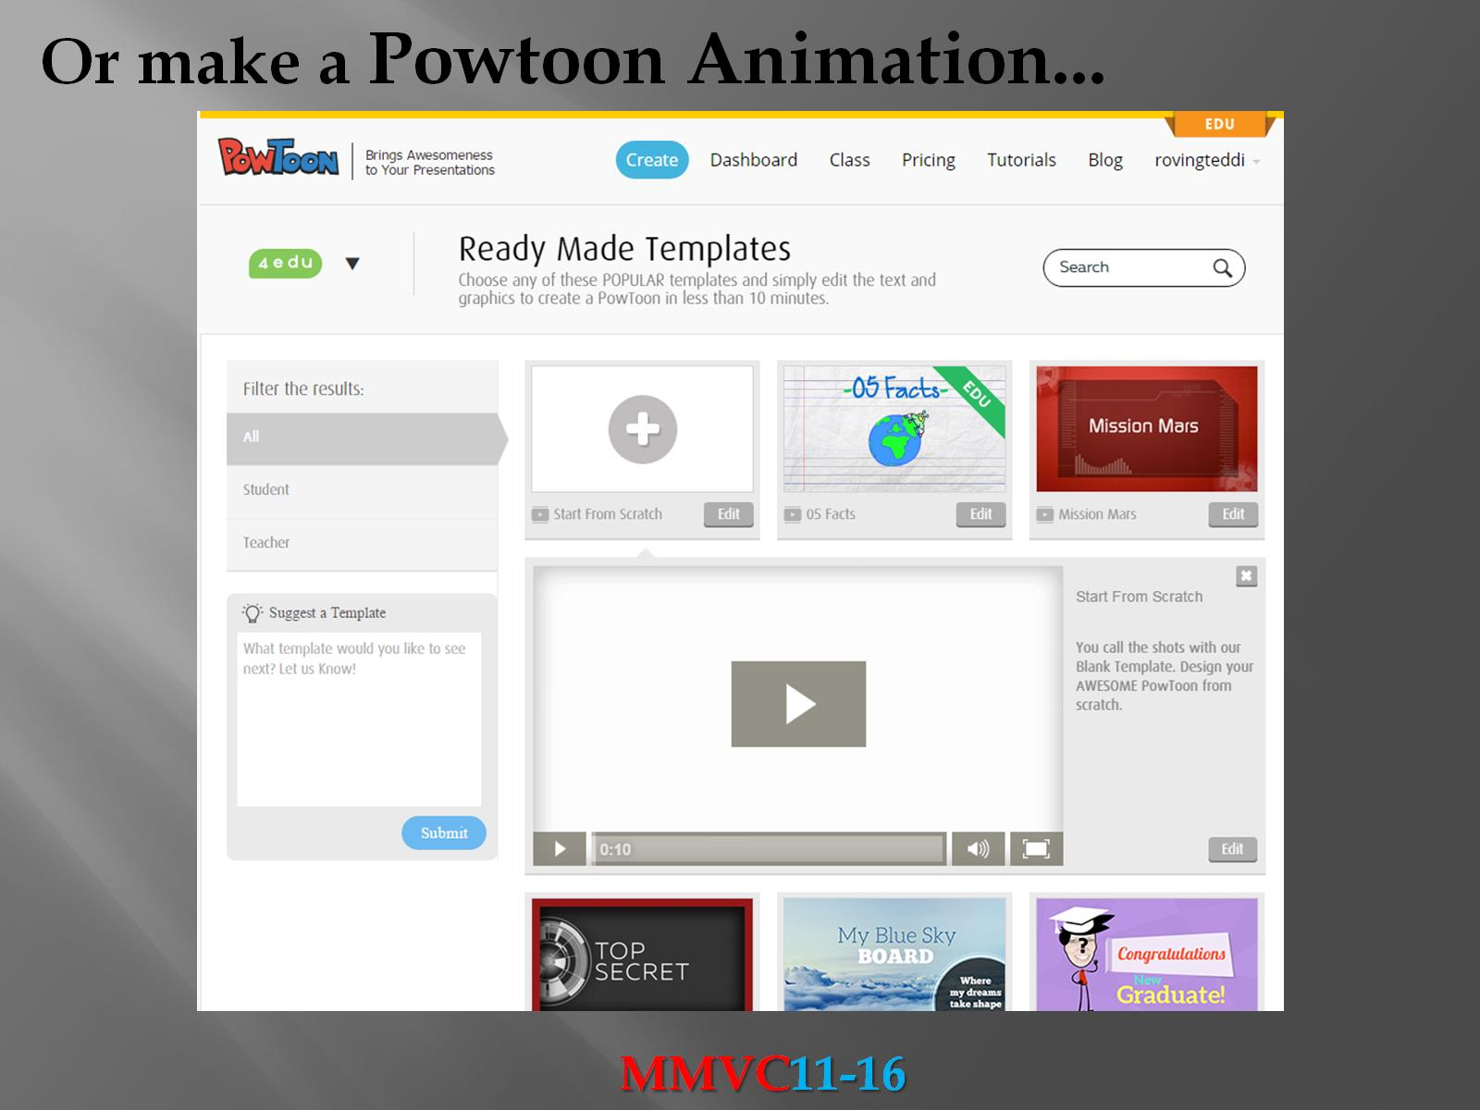

Slide 10


Slide 11


Slide 12


Slide 13
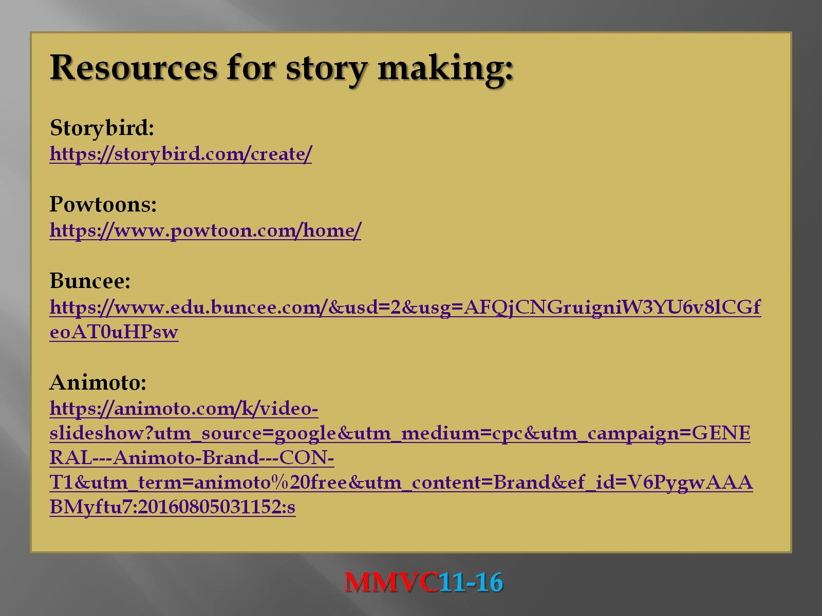

Slide 14
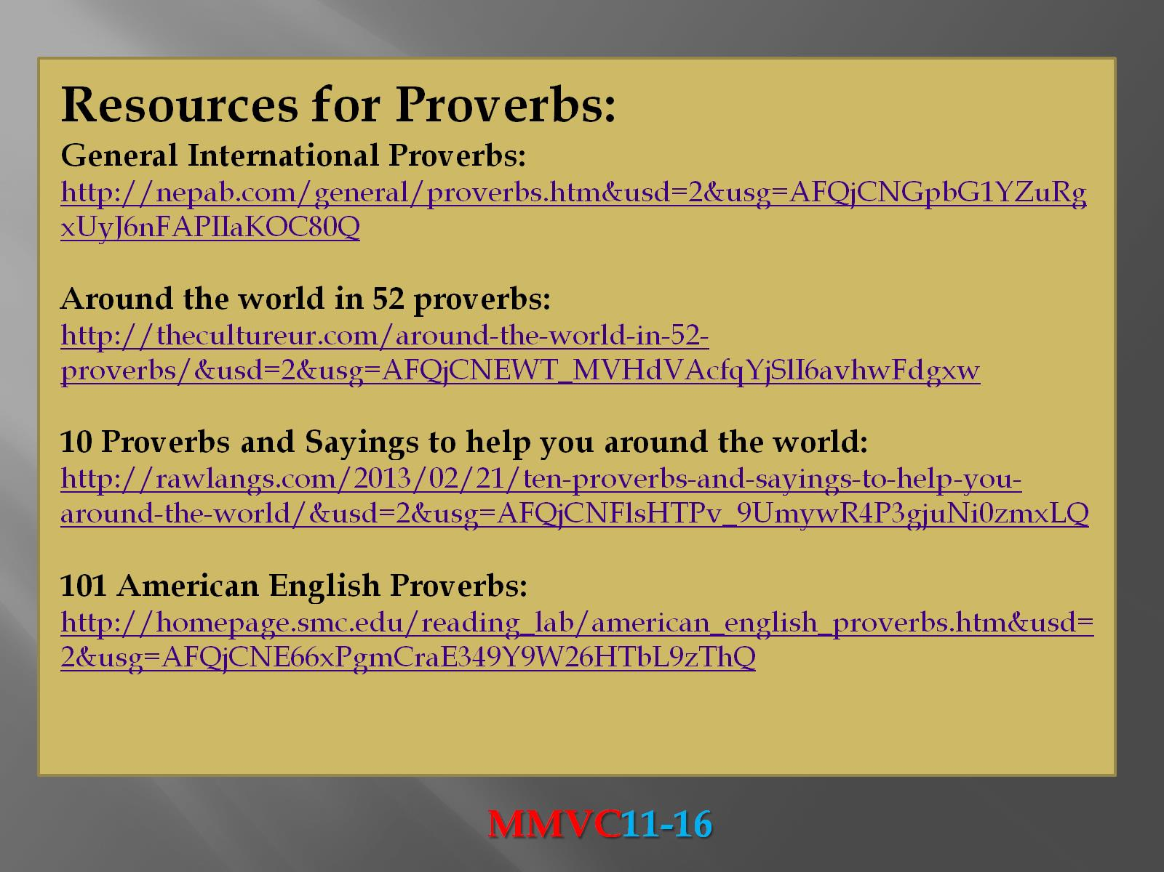

Slide 15
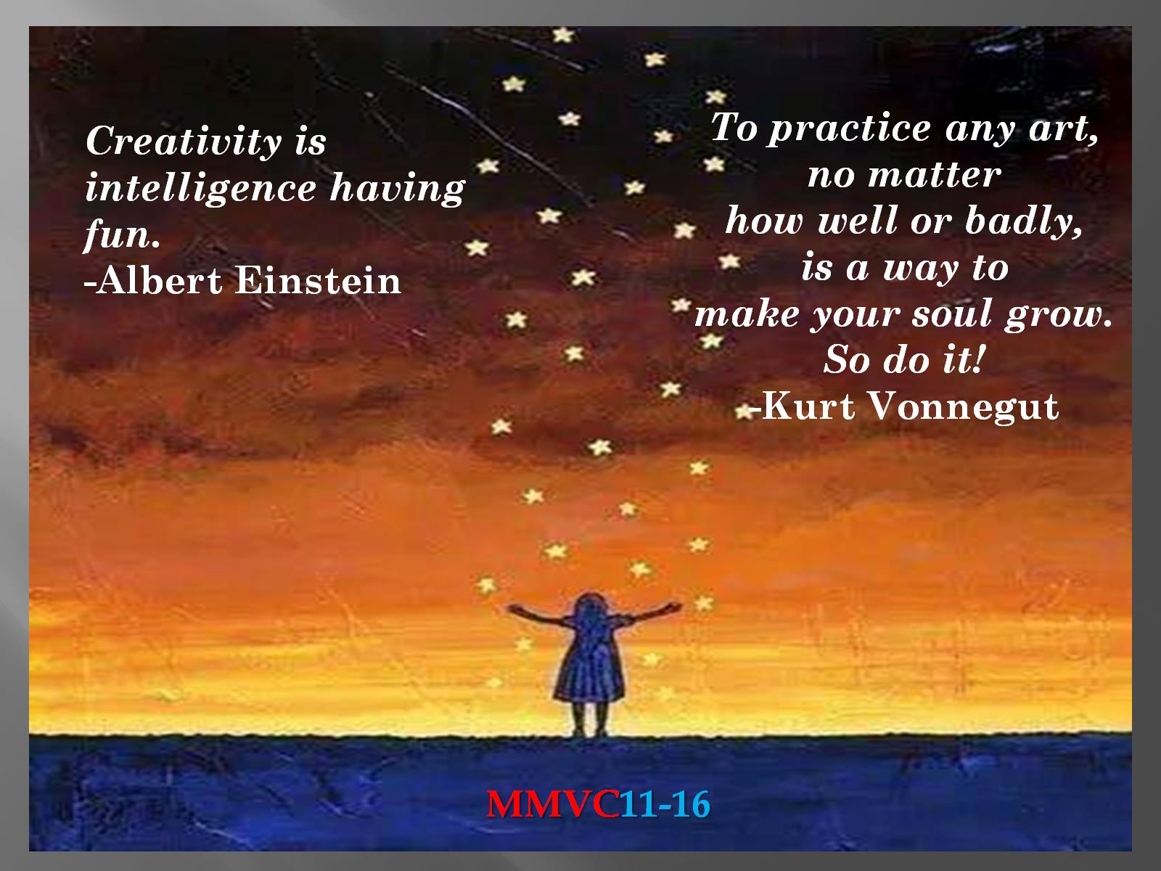

Slide 16


