Slide 1

Proverbs Brought to Life with Powtoons

Slide 2
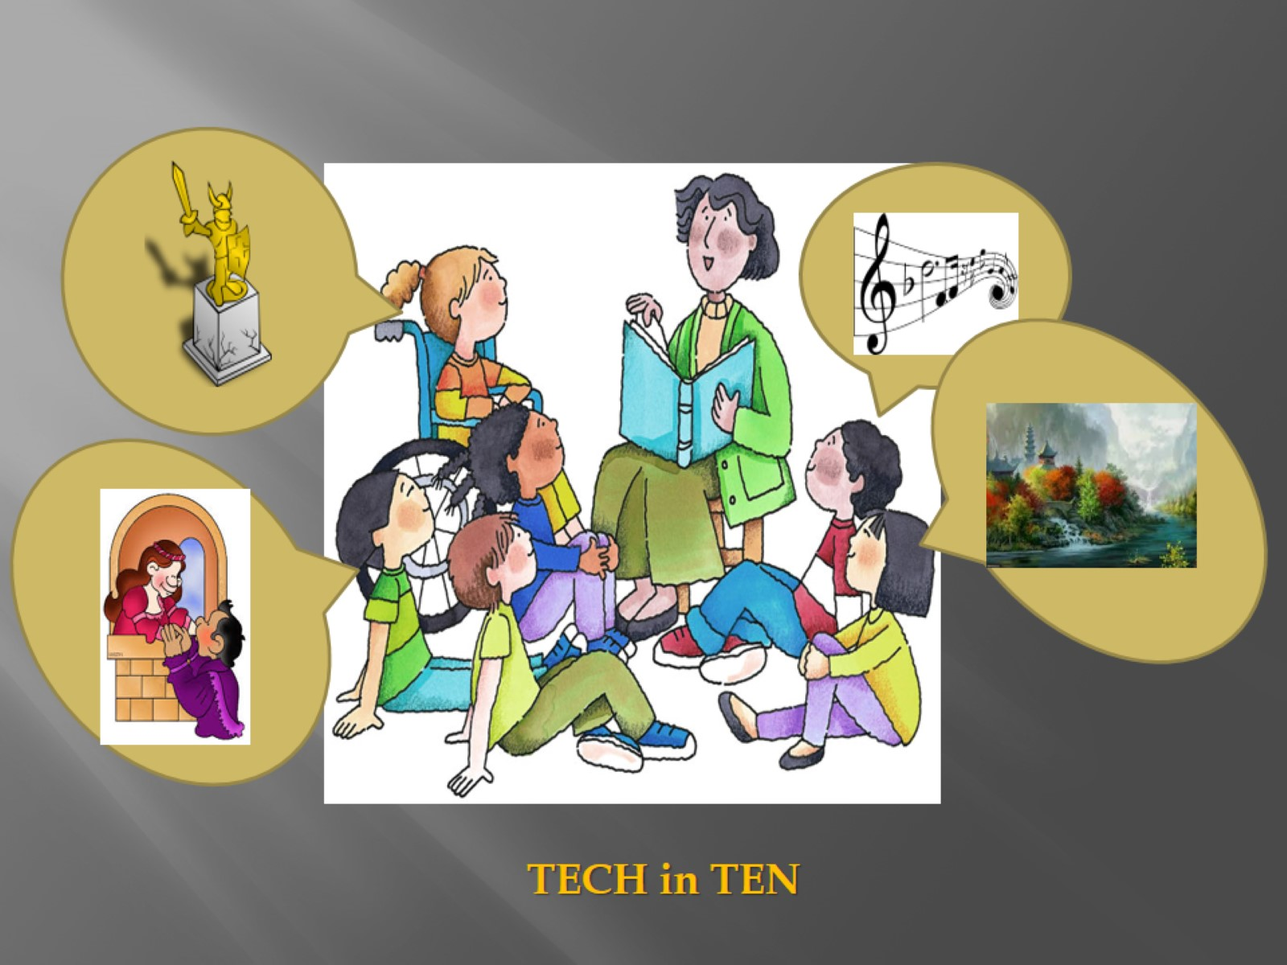

Slide 3

Proverb

Slide 4
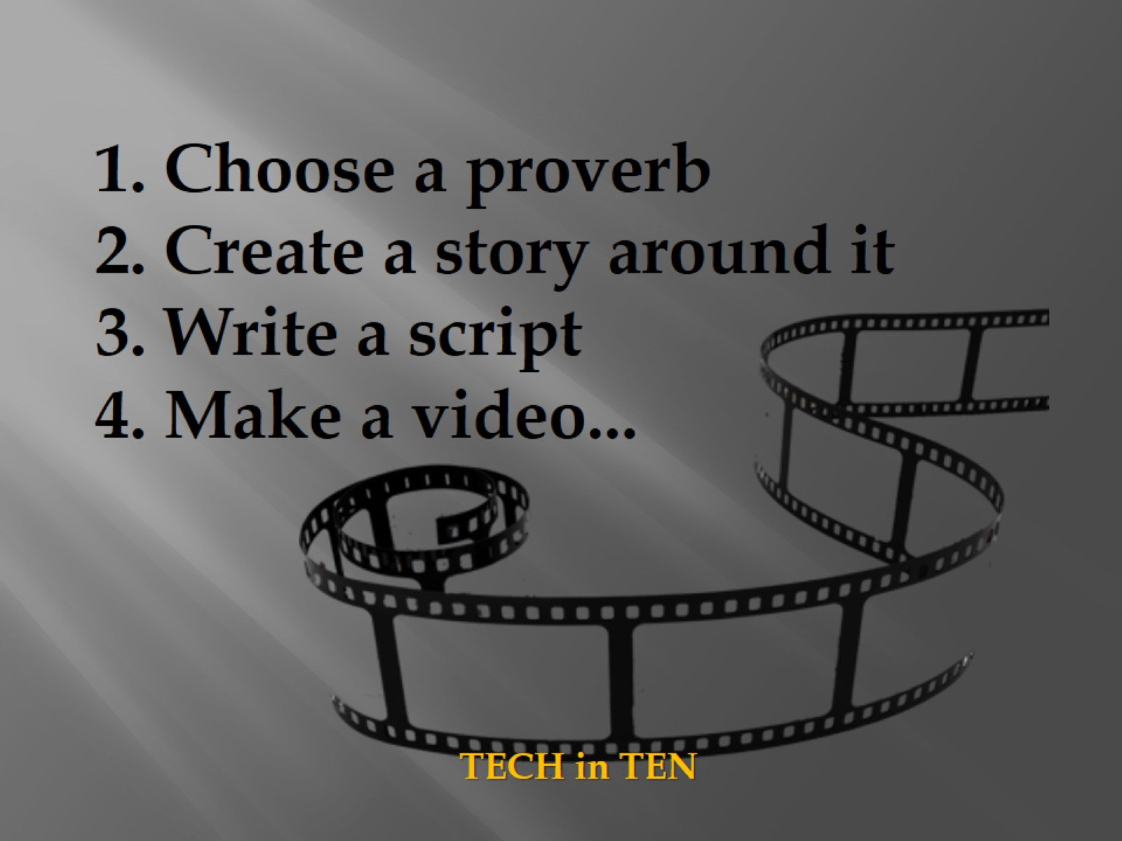

Slide 5
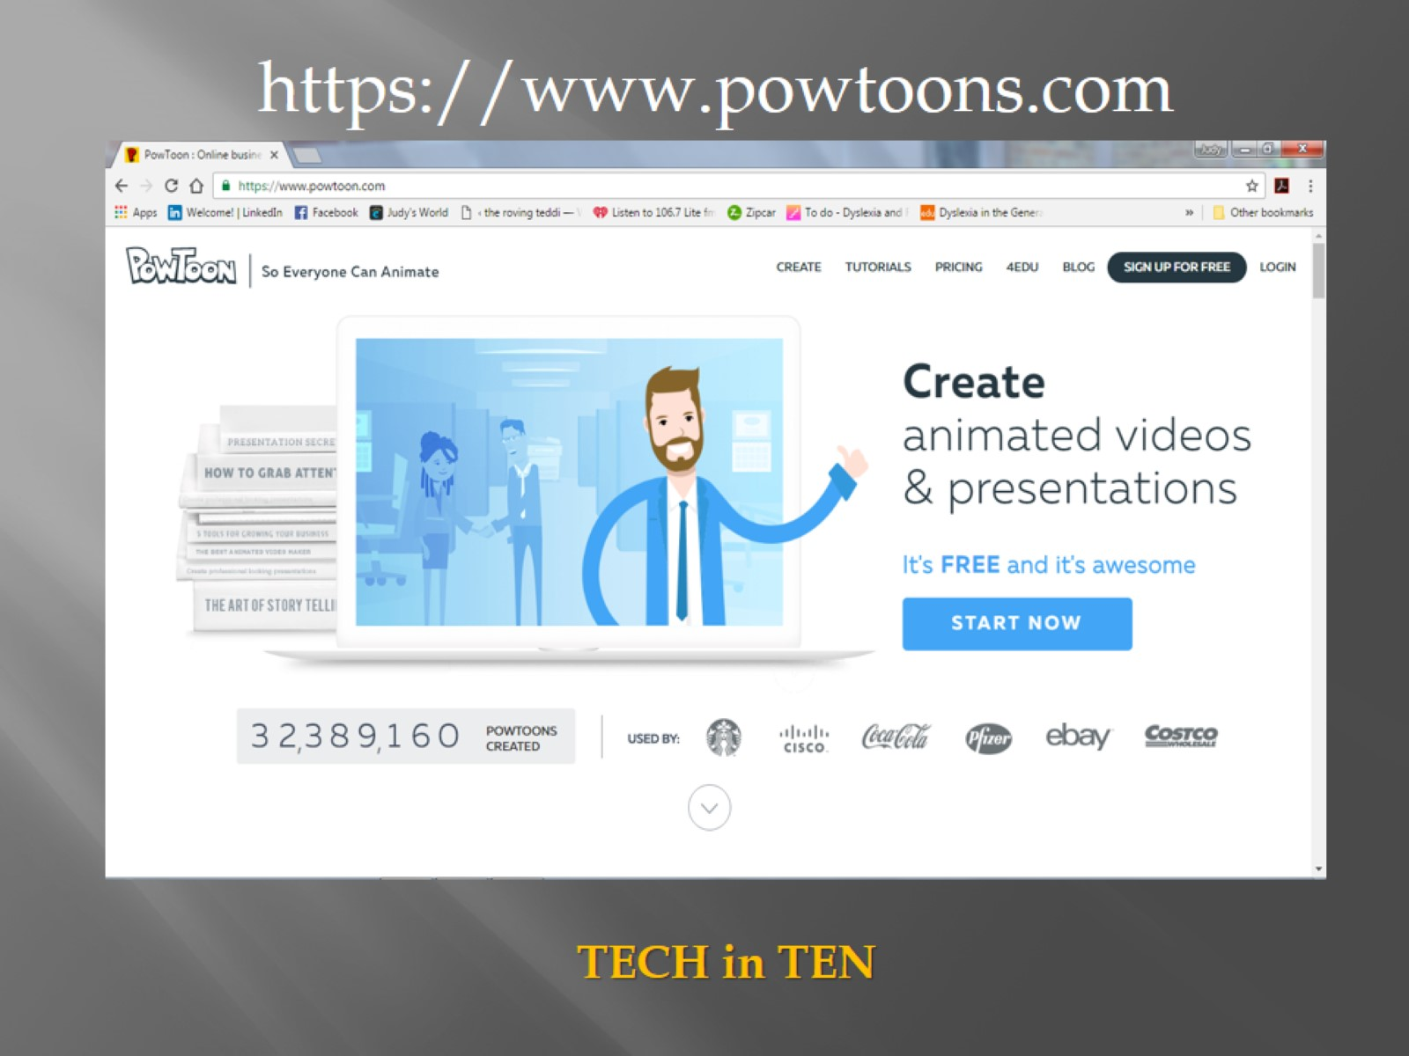

Slide 6


Slide 7
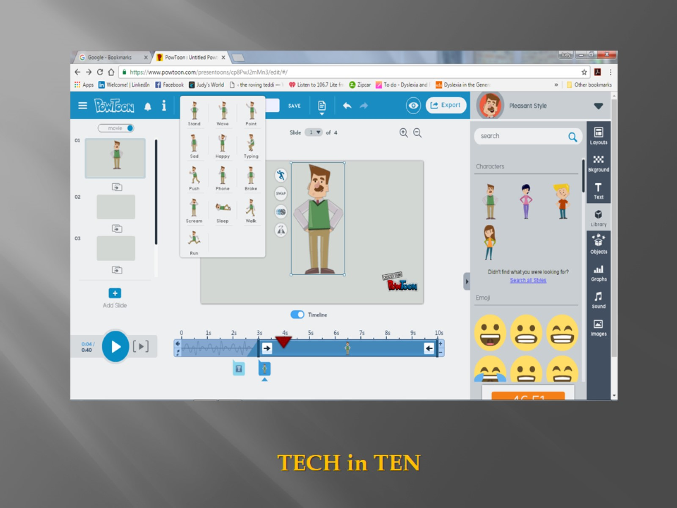

Slide 8
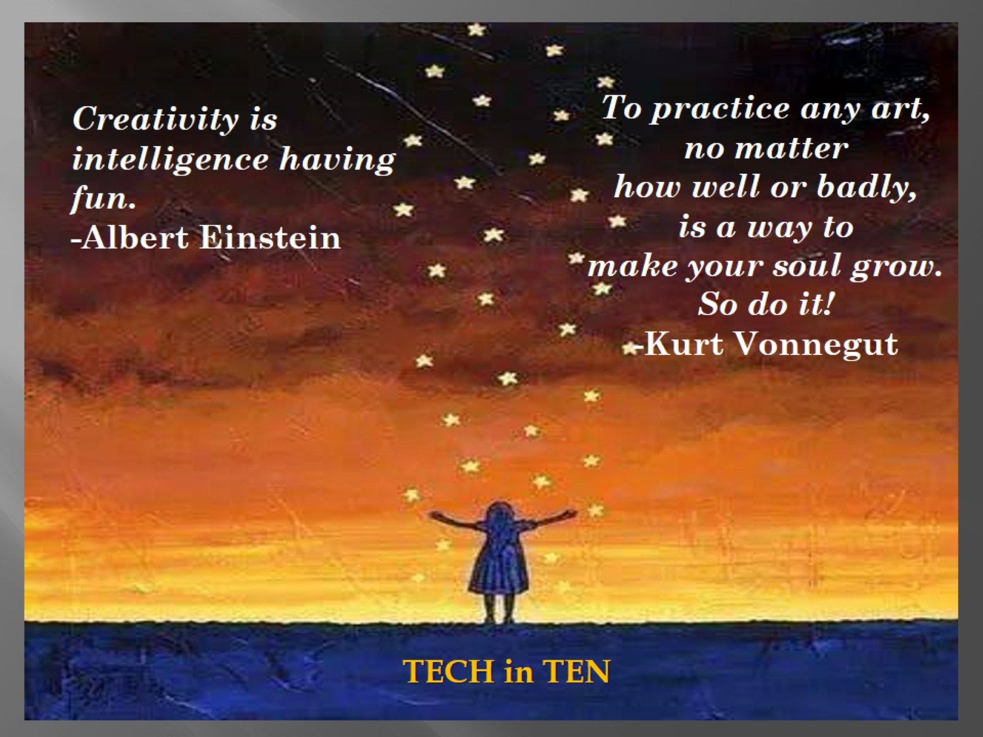

Slide 9


