Slide 1


Slide 2
What are TEDtalks ...and who is TED.com??
“TED is a global community, welcoming people from every discipline and culture who seek a deeper understanding of the world. We believe passionately in the power of ideas to change attitudes, lives and, ultimately, the world. On TED.com, we're building a clearinghouse of free knowledge from the world's most inspired thinkers — and a community of curious souls to engage with ideas and each other, both online and at TED and TEDx events around the world, all year long.”
Retrieved from: http://www.ted.com/about/our-organization

Slide 3
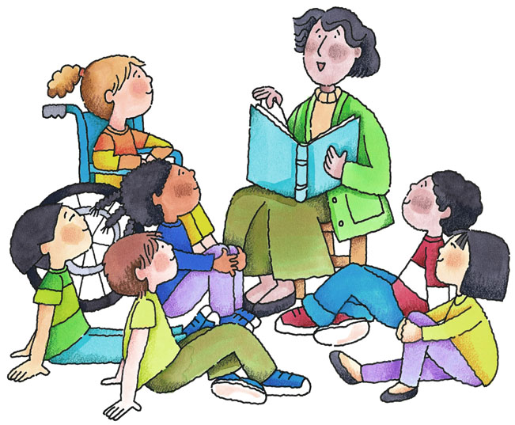

Slide 4


Slide 5
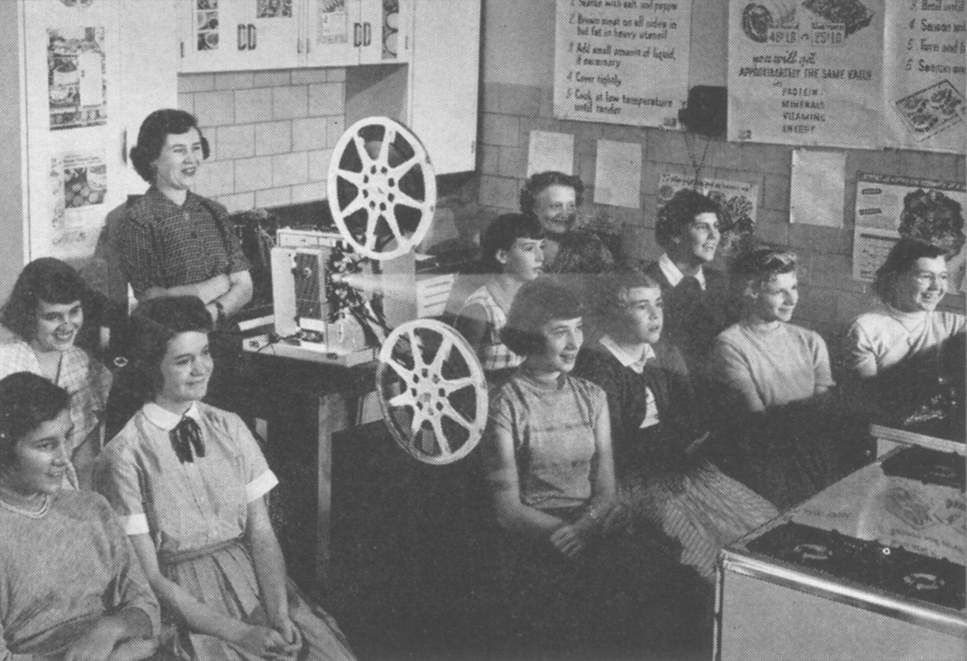

Slide 6
Things to think about
when choosing
which TED talk to work with:
Who are your students?
What is the theme of your lesson?
What is the object of your lesson?

Slide 7



Who are your Students?
Are they children or adults?
What are their interests?

Slide 8
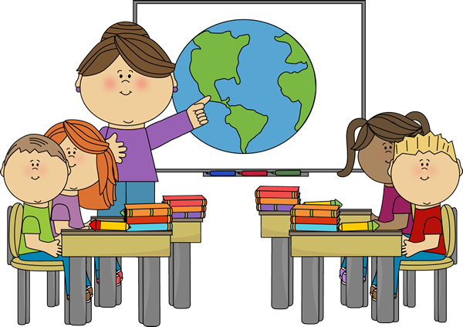
What is the theme of your lesson?

Slide 9



What is the object of your lesson?

Slide 10
Find your TED talk...
http://www.ted.com/
http://www.ted.com/talks
http://ed.ted.com/lessons

Slide 11
http://www.ted.com/talks/frans_lanting_photos_that_give_voice_to_the_animal_kingdom
Listening For:
Main ideas
Supporting details
Inferences
Grammar words such as articles, prepositions, etc.

Slide 12
Speaking:
Word Stress
Intonation
Rhythm
Register

Slide 13
“00:11 Humanity takes center stage at TED, but I would like to add a voice for the animals, whose bodies and minds and spirits shaped us.
00:24 Some years ago, it was my good fortune to meet a tribal elder on an island not far from Vancouver. His name is Jimmy Smith, and he shared a story with me that is told among his people, who call themselves the Kwikwasut'inuxw.
00:42 Once upon a time, he told me, all animals on Earth were one. Even though they look different on the outside, inside, they're all the same, and from time to time they would gather at a sacred cave deep inside the forest to celebrate their unity. When they arrived, they would all take off their skins. Raven shed his feathers, bear his fur, and salmon her scales, and then, they would dance. But one day, a human made it to the cave and laughed at what he saw because he did not understand. Embarrassed, the animals fled, and that was the last time they revealed themselves this way. “
Retrieved from:
http://www.ted.com/talks/frans_lanting_photos_that_give_voice_to_the_animal_kingdom/transcript?language=en

Slide 14
Reading the transcripts:
Scan for the main idea
Identify key details
Find inferences
Identify key grammar structures
Compare spoken English vs
written English

Slide 15
Writing:
Use the TED talk as a prompt
Choose a detail from the TED talk to research further
Use two TED talks with contrasting ideas to set up an argumentative essay or a debate

Slide 16
No Access to technology in the classroom?
Use the transcripts:
For reading skills
As a script for speaking skills
For practicing listening skills
For identifying grammar structures

Slide 17
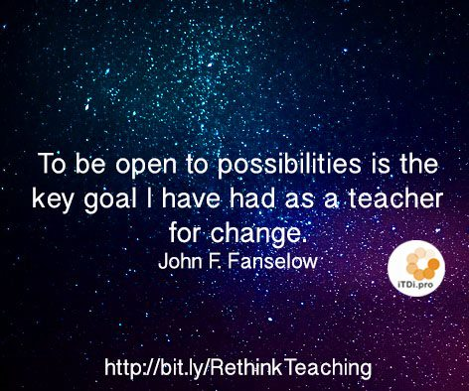
Remember...
“We are teachers as well as students and our students are our teachers”

Slide 18
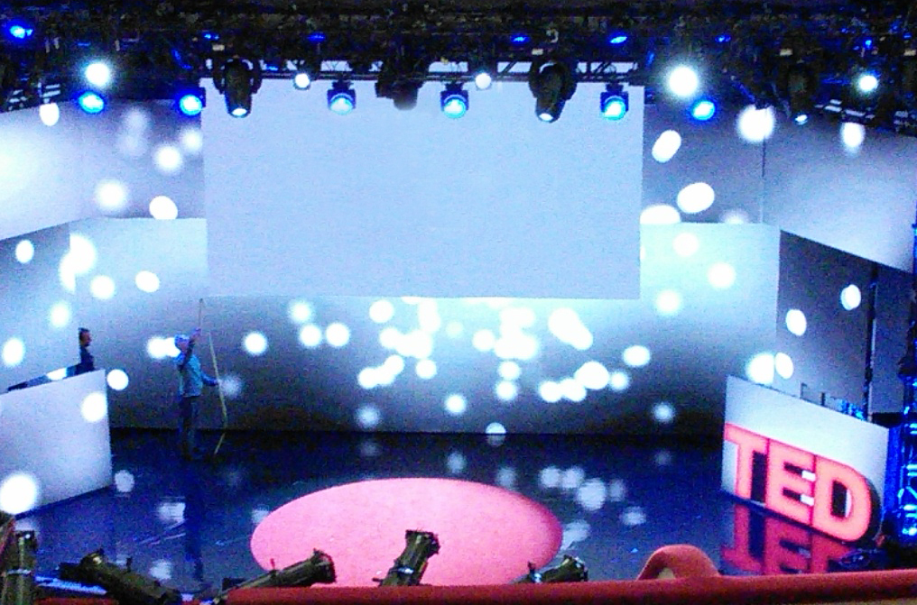
Thank you to the following for your support...
Nat’l Geographic Learning
/CENGAGE Learning –
21st Century Reading with TED talk
https://shar.es/15ednE
Dr. Nellie Deutsch
www.facebook.com/AdventuresInReadingWritingESOL
www.linkedin.com/in/judywongrteddi
http://judysworld.edublogs.org/

