Slide 1

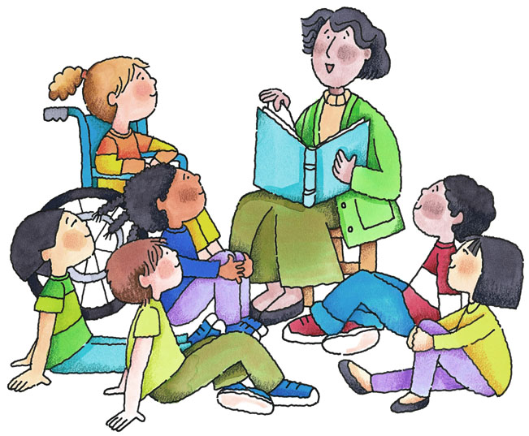


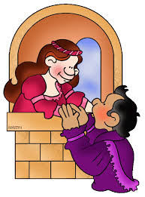
ELL as Art
“Art is English Language Learning
...and English Language Learning is Art.”
...or how we use Art in our ELL or ELL in our Art

Slide 2

In teaching English,
we are uncovering the light
to a world unseen, unheard and unfelt...
and what is art but an open door
to a world unseen, unheard and unfelt.

Slide 3
Excerpt from Edutopia:
A Research-Based Approach to Arts Integration
by Vanessa Vega
Former Edutopia Senior Manager of Research
August 29, 2012
Artful Thinking
Artful Thinking is a program developed by Harvard's Project Zero in collaboration with the Traverse City Area Public Schools in Michigan. It is an approach to teaching creative thinking that uses six routines to explore artistic works and subjects across the curriculum. These routines contain strategies to deepen art experiences.
Reasoning: Asking, "What makes you say that?" to prompt students to cite evidence to support claims
Perspective-taking: Asking, "What does the character (or author) perceive, know, or care about?" to understand diverse perspectives and ways of approaching problems
Questioning and investigating: Brainstorming questions and using prompts to spark observations and inquiry (e.g., How? What? When? Why? What if? and "I see," "I think," "I wonder")
Observing and describing: Describing and elaborating upon what you see and/or hear (e.g., imagining the artwork as the beginning, middle, or ending of a story, and/or describing formal qualities of a work of art)
Comparing and connecting new ideas to prior knowledge: Asking questions to prompt core ideas and connecting, extending, and/or challenging core ideas
Finding complexity: In order to uncover multiple dimensions and layers, asking questions such as, "How is it complicated?" "What are the different layers and pieces?" "What are its parts and purposes?" "What insights do you have about the topic?"

Slide 4
Arts integration naturally incorporates many cognitive activities that have been shown to improve long-term memory (Rinne, et al., 2011).
Elaboration | Adding meaning to, and/or incorporating, information that is to be remembered. Example: Create stories, pictures, or nonverbal expressions that express and/or integrate the content being learned in elaborated expressions.
Rehearsal of Meaning (in a variety of nonverbal forms) | Repeating content over and over until it is memorized; however, rereading, or even elaborating upon meaning, is not as effective as recalling and reconstructing the information from a cue (Karpicke & Blunt, 2011). Example: Watch a movie or listen to a song about mathematical equations.
Generation | Generating information (pictures, stories, songs, poems) in response to a visual or physical cue. Retrieving and reconstructing the information has been shown to be more effective in promoting learning than elaboration (Karpicke & Blunt, 2011). Example: Take a photograph showing a law of physics.
Enactment | Performing action phrases, as in drama or dance, improves memory. Example: Co-create and/or participate in a dance that incorporates understanding of meteorology to represent seasons, weather patterns, and atmospheric conditions.

Slide 5
Oral Production | Singing or theatrical production that requires information to be remembered and recited orally promotes retention. Example: Create a three-minute skit or song that helps teach the Pythagorean theorem.
Effort After Meaning | Briefly puzzling over the meaning before figuring it out can lead to better memory. (If students must decode meaning from art, they are more likely to remember the meaning.) Example: Study Guernica (1937) by Pablo Picasso and describe what the artist was trying to express, citing specific details in the work to support your claims.
Emotional Arousal (vs. neutral) | Content that generates higher levels of emotional arousal can promote memory for that content, but arousal needs to be at an optimal level. Too much arousal distracts from the content, and high levels of negative arousal (fear or stress) can lead to impaired learning. Example: Write about a personal experience that relates to a cultural or social issue that you feel needs to be addressed, and then design a poster or performance to represent your knowledge and feelings about the topic.
Pictorial Representation (a.k.a. picture superiority effect) | Visual information is better retained than information presented verbally or as text. In other words, people tend to better remember things they have seen than things they have heard or read. Example: Use striking visual images, such as artworks, historical artifacts, scientific images, or graphs to represent important concepts.
For planning arts-integrated lessons, Hardiman's Brain-Targeted Teaching Model (2012) also provides a useful reference for translating findings from cognitive neuroscience into instructional practices.

Slide 6
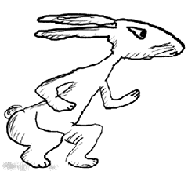
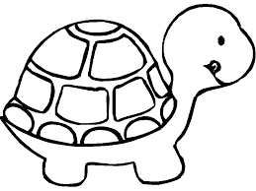

Slide 7
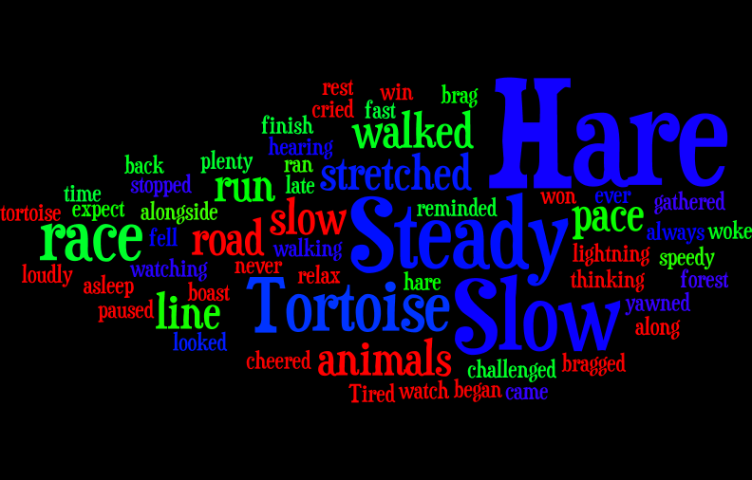
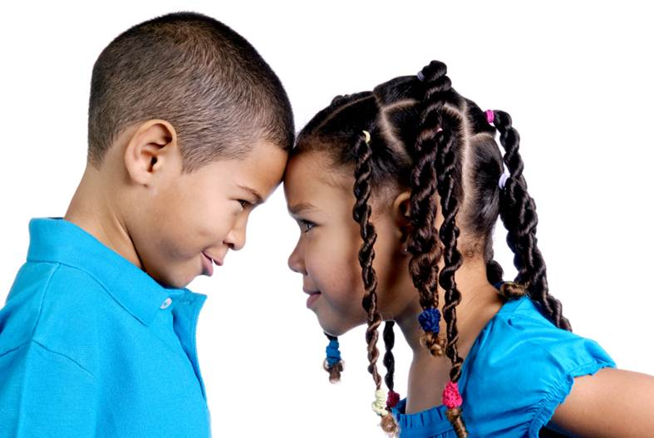

Slide 8
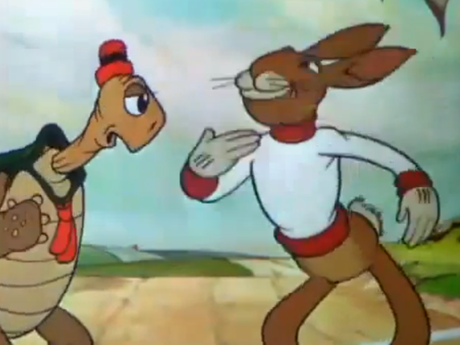

Slide 9

Resources used in the story making:
VoiceThread
Powtoons
Wordle
Bibliography
Vega, Vanessa, A Research-Based Approach to Arts Integration, http://www.edutopia.org/stw-arts-integration-research
Abrami, P.C., Bernard, R.M., Borokhovski, E., Wade, A., Surkes, M.A., Tamim, R., & Zhang, D. (2008). Instructional Interventions Affecting Critical Thinking Skills and Dispositions: A Stage 1 Meta-Analysis. Review of Educational Research, 78(4), 1102-1134.
Hardiman, M. (2012). The Brain-Targeted Teaching Model for 21st-Century Schools. Thousand Oaks, CA: Corwin.

Slide 10

Creativity is
intelligence having fun.
-Albert Einstein
To practice any art,
no matter
how well or badly,
is a way to
make your soul grow. So do it!
-Kurt Vonnegut
Email: TheaterforELL@gmail.com
Blog: http://judysworld.edublogs.org/
Facebook:
https://www.facebook.com/AdventuresInReadingWritingESOL

